Slide 1

By ALM Team

Slide 2
Agenda
Why Jira Agile?
Scrum
Kanban
Integrations

Slide 3
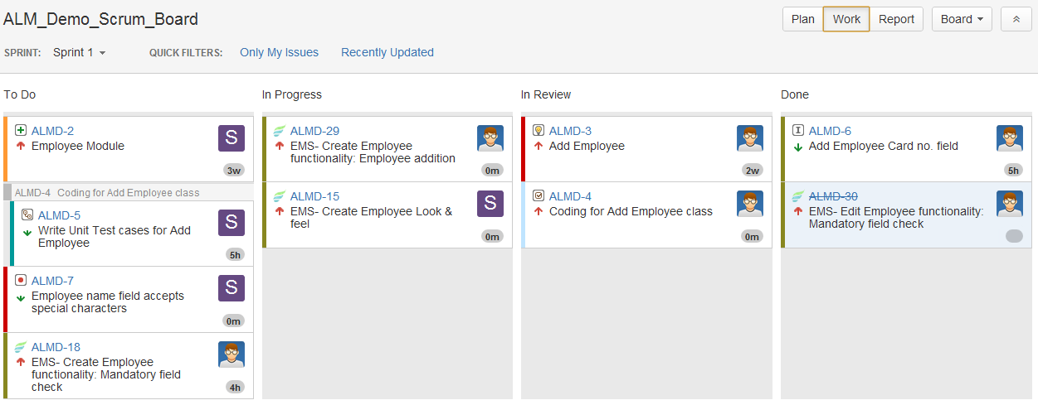
Why Jira Agile? | Scrum | Kanban | Integrations
Plan
Estimate
Prioritize
Execute
Evolve
Flexible planning: JIRA Agile's rich feature set enables to flexibly plan and adopt the best agile practices for your organization.

Slide 4
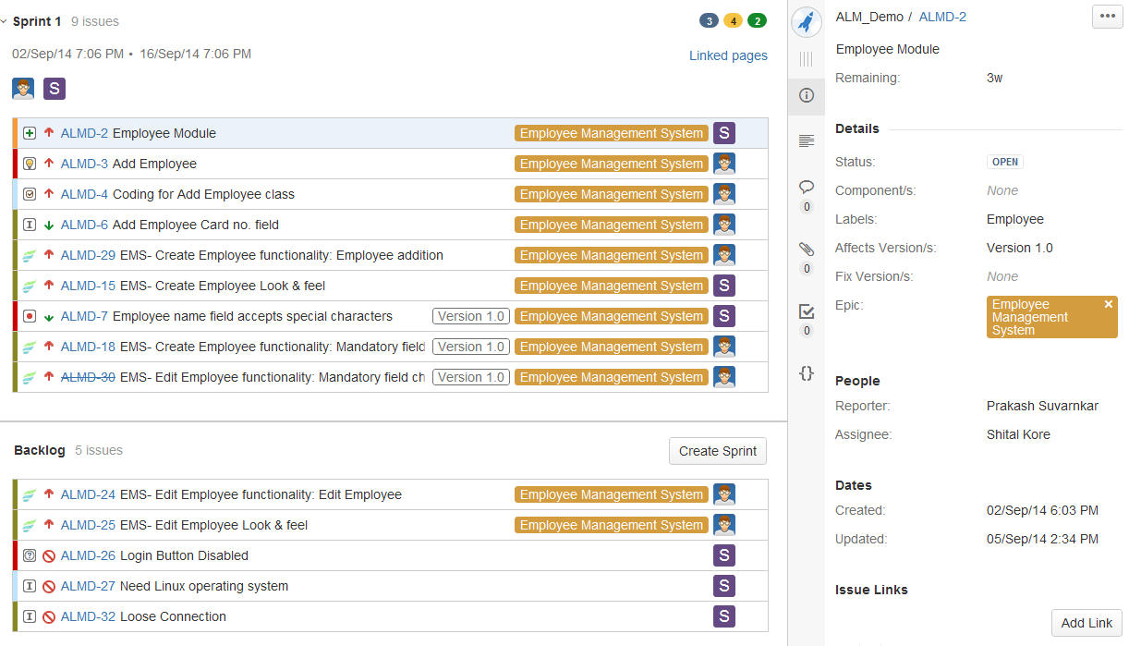
Why Jira Agile? | Scrum | Kanban | Integrations
Plan
Estimate
Prioritize
Execute
Evolve
Accurate estimations: Add estimates and bugs to user stories while in a planning meeting.
Tracking estimates on each story helps team become more accurate.
Use story points, ideal hours, t-shirt sizes, or your own estimation technique – JIRA Agile supports them all.

Slide 5
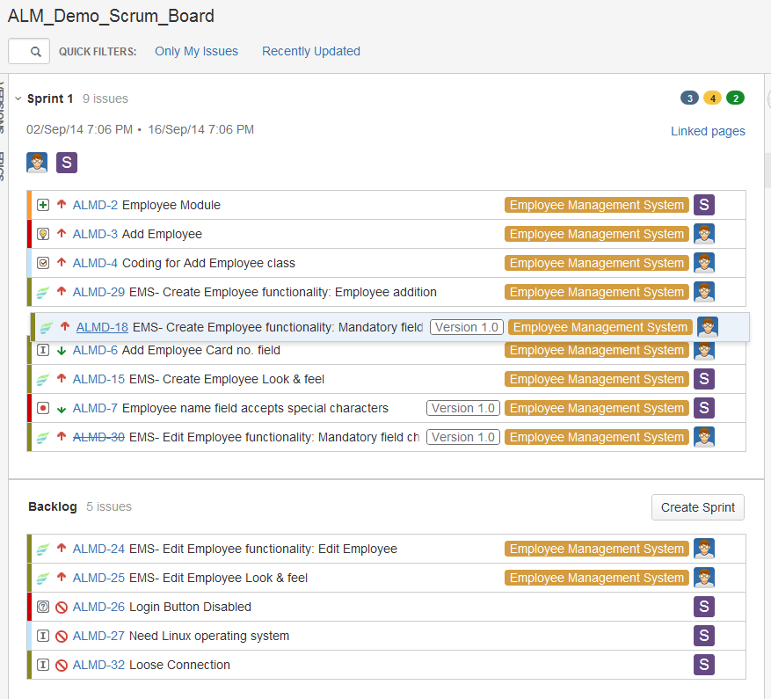
Why Jira Agile? | Scrum | Kanban | Integrations
Plan
Estimate
Prioritize
Execute
Evolve
Value-driven prioritization: Order user stories and bugs in the product backlog by dragging and dropping issues.
Put the stories that deliver the most customer value at the top of the backlog.

Slide 6
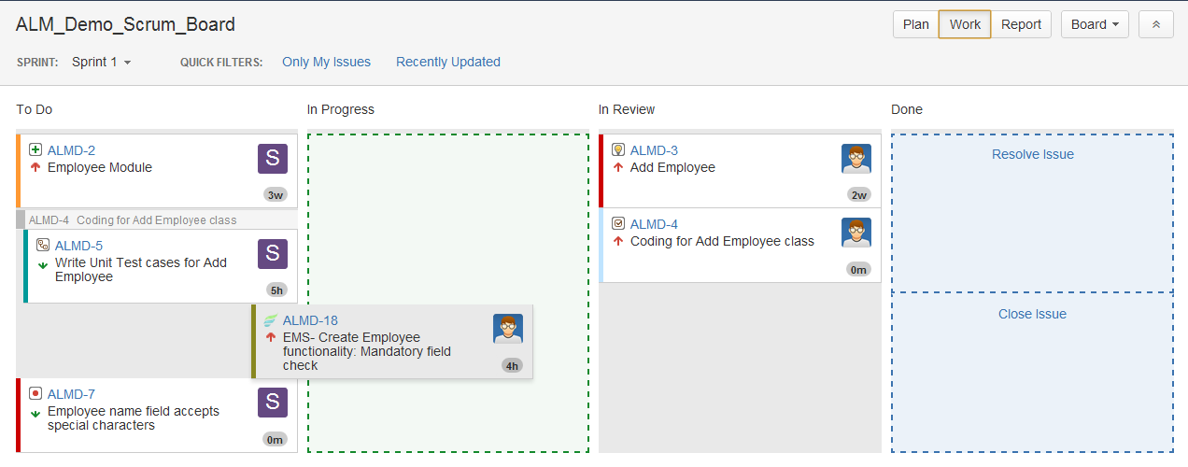
Why Jira Agile? | Scrum | Kanban | Integrations
Plan
Estimate
Prioritize
Execute
Evolve
Transparent execution: Update the status of stories by drag and drop, or edit story details directly in the integrated detail view.
Brings the transparency as everyone shares the same view.

Slide 7
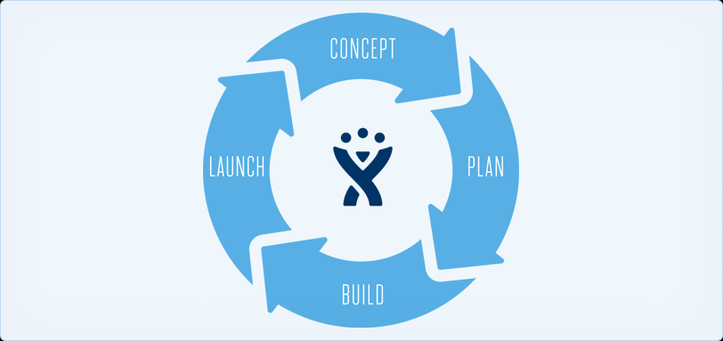
Why Jira Agile? | Scrum | Kanban | Integrations
Plan
Estimate
Prioritize
Execute
Evolve
Scalable evolution: Agile is all about scale. Extend JIRA's issue types, fields, and workflows to adapt as your team evolves.
Manage issues from multiple projects in a single board, groom huge backlogs with multi-select ranking.

Slide 8
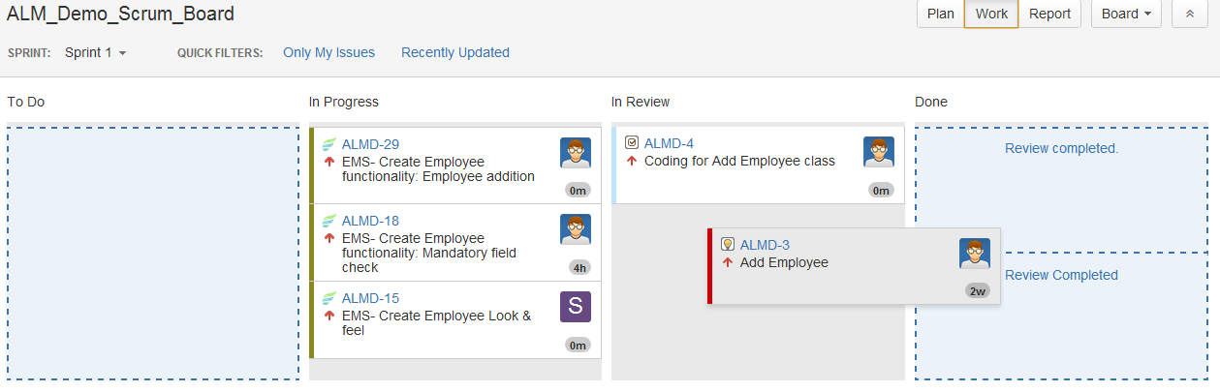
Why Jira Agile? | Scrum | Kanban | Integrations
Adopt
Schedule
Launch
Deliver
Grow
Time-tested techniques: Teams using scrum plan work in sprints, short blocks of time in which the team can estimate, and return value back to the customer.
Use scrum to deliver complex solutions in a structured, predictable way.

Slide 9
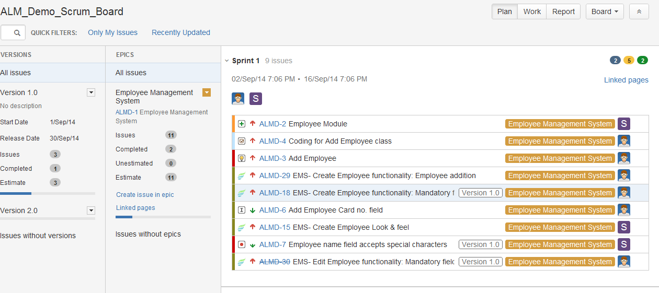
Why Jira Agile? | Scrum | Kanban | Integrations
Adopt
Schedule
Launch
Deliver
Grow
Prioritized organization: Ensuring the team is working on the highest-priority items first.
With JIRA Agile, the team can organize stories in sprints, in larger epics, and across release versions.

Slide 10
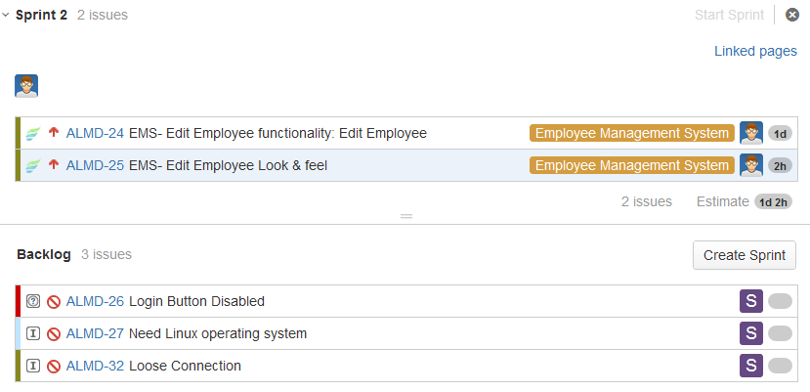
Why Jira Agile? | Scrum | Kanban | Integrations
Adopt
Schedule
Launch
Deliver
Grow
Effective collaboration: Add backlog issues to sprint with the sprint marker. All stories above the sprint marker get discussed in the sprint planning session and are committed for current sprint.

Slide 11
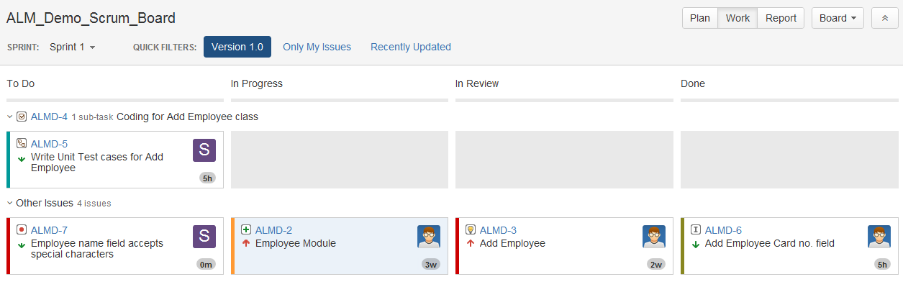
Why Jira Agile? | Scrum | Kanban | Integrations
Adopt
Schedule
Launch
Deliver
Grow
Agile development and delivery: Swimlanes to see progress on individual stories, quick filters highlight specific areas that need attention.
Create personal quick filters that make it easy to report in for standup.

Slide 12
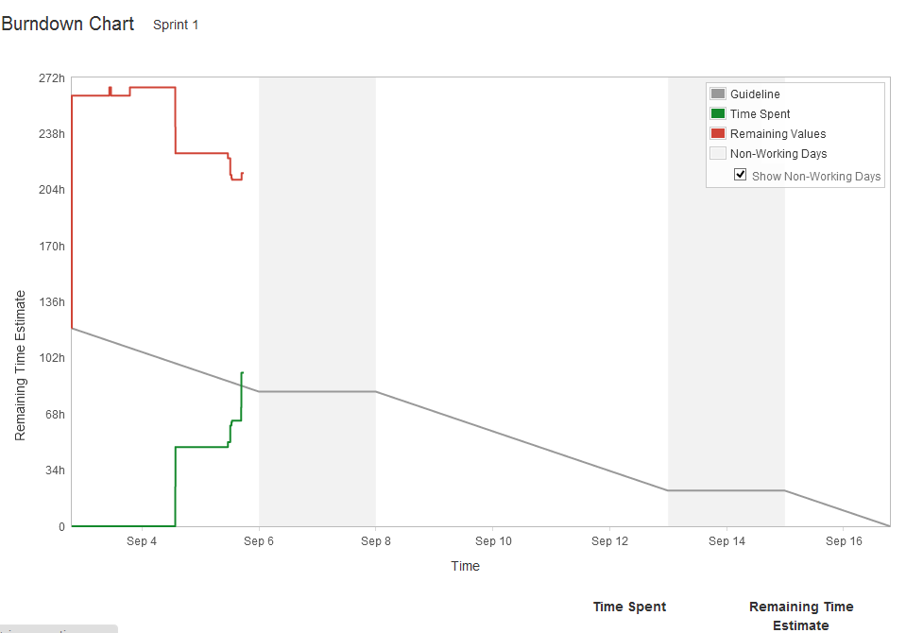
Why Jira Agile? | Scrum | Kanban | Integrations
Adopt
Schedule
Launch
Deliver
Grow
Actionable results: Retrospectives are sprint reviews which to evolve.
JIRA Agile's extensive reports give the team critical insight into their agile process and results. Like Burndown chart to get progress towards the sprint commitment.

Slide 13
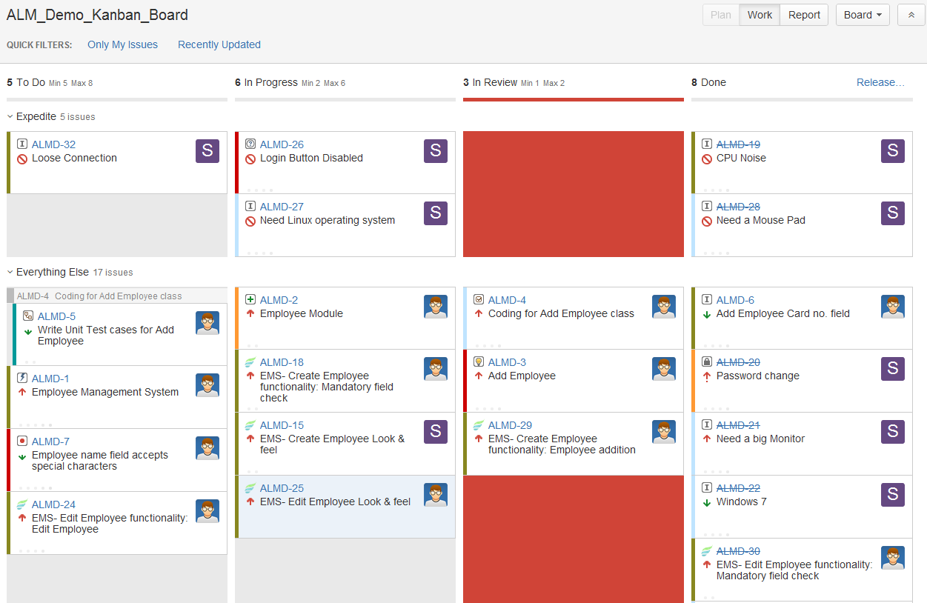
Why Jira Agile? | Scrum | Kanban | Integrations
Champion
Visualize
Organize
Optimize
Analyze
Established methodology: Catalyst for change through small, incremental improvements to your existing process – be it scrum or otherwise.
Applied to software development, DevOps, IT operations, and many other processes.

Slide 14
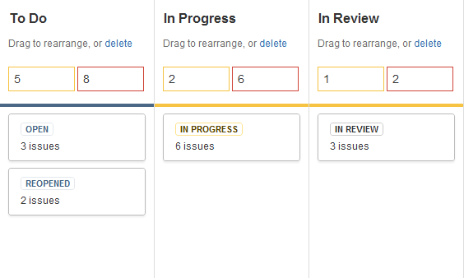
Why Jira Agile? | Scrum | Kanban | Integrations
Champion
Visualize
Organize
Optimize
Analyze
Transparent workflow: Map columns to the steps of your existing workflow. Add or remove columns as the process evolves over time.

Slide 15
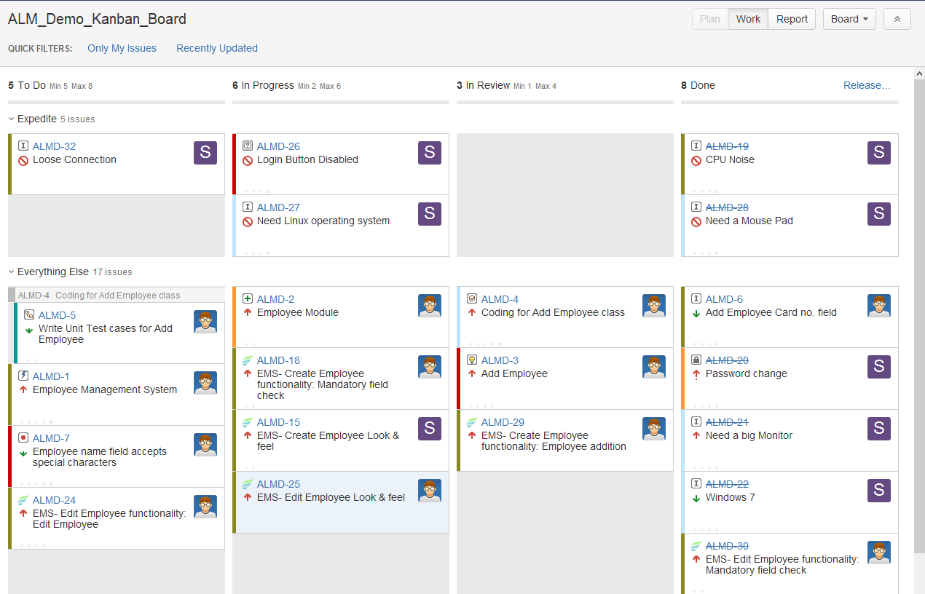
Why Jira Agile? | Scrum | Kanban | Integrations
Champion
Visualize
Organize
Optimize
Analyze
Personalized implementation: Separate issues on your board using swimlanes like Expedite.
Swimlanes may be configured using the JIRA Query Language (JQL), giving the team complete control over the issue selection criteria.

Slide 16
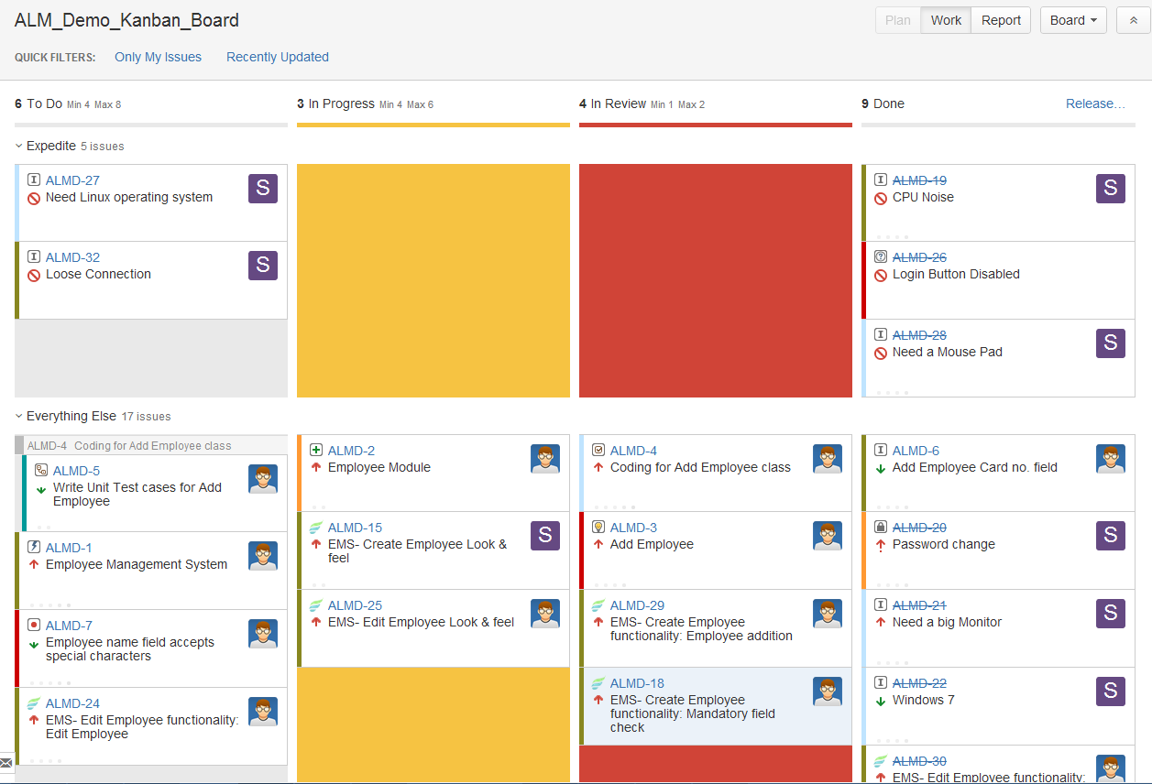
Why Jira Agile? | Scrum | Kanban | Integrations
Champion
Visualize
Organize
Optimize
Analyze
Supercharged productivity:Set minimum and maximum column constraints to identify spare capacity and bottlenecks.
Optimizing flow leads to greater productivity.

Slide 17
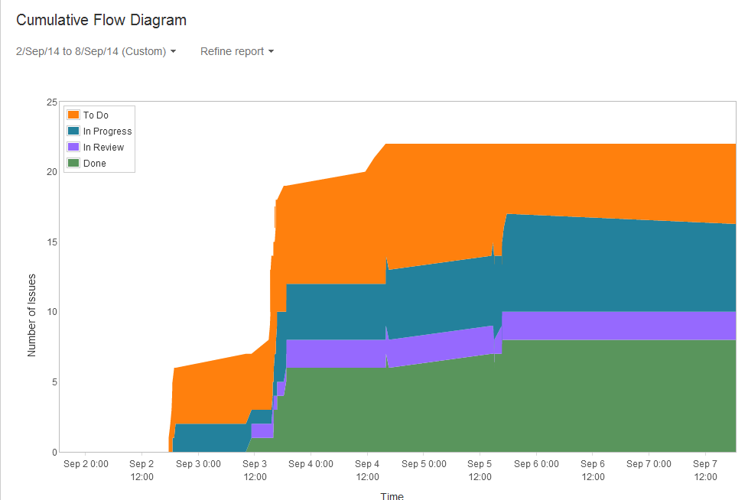
Why Jira Agile? | Scrum | Kanban | Integrations
Champion
Visualize
Organize
Optimize
Analyze
Constructive analysis: Monitor current trends and analyze past progress with the cumulative flow diagram.
See where work is building up and bottlenecks occur.

Slide 18
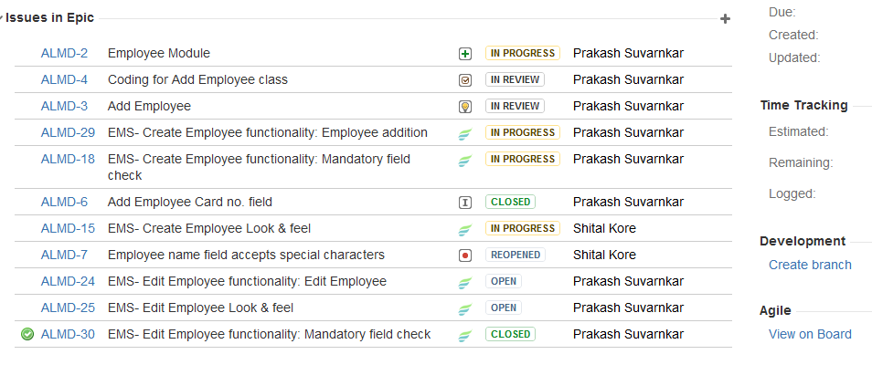
Why Jira Agile? | Scrum | Kanban | Integrations
Jira
Confluence
Developer Tools
Rock-solid foundation: Build work management platform with flexible workflows, issue types, fields, and powerful search.
JIRA Agile works with JIRA Capture supporting exploratory testing for agile teams.

Slide 19
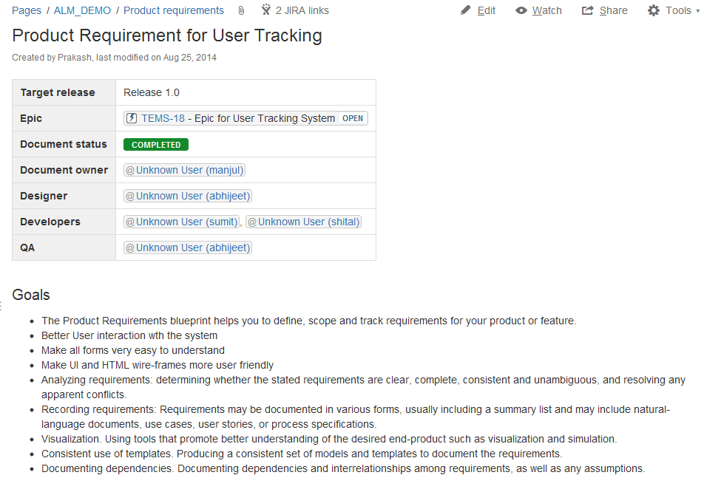
Why Jira Agile? | Scrum | Kanban | Integrations
Jira
Confluence
Developer Tools
Consolidated knowledge base: JIRA Agile integrates with Confluence to link requirements to user stories.
Consolidate team's activities – like important sprint dates and team leave with Confluence Team Calendars.

Slide 20
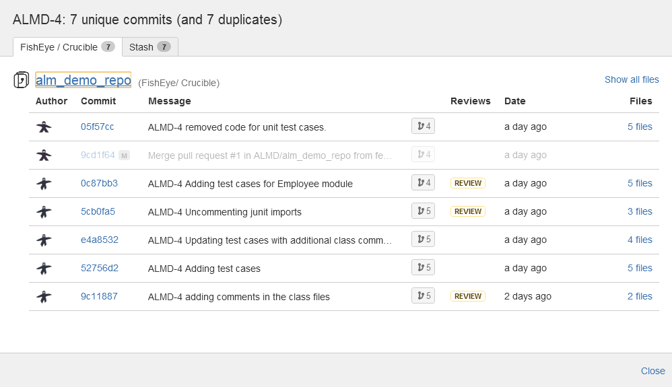
Why Jira Agile? | Scrum | Kanban | Integrations
Jira
Confluence
Developer Tools
Issues, stories, and source – together: Add JIRA issue key to commit message to bridge the gap between user story in JIRA Agile and source code.
Understand what issues got fixed, when, and what code changes fixed those issues.

Slide 21

Any Questions?

Slide 22
Thank You!

